Slide 1

Scientific programming patterns
Lisa Schwetlick and Pietro Berkes

Slide 2

What is wrong with y’all?!
You studied the language
You learned the libraries
You coded for months
And yet the code still feels like a 7-headed apocaliptic monster. Changes are painful, new features break old functionality, reproducing previous results becomes a git-checkout juggling exercise

Slide 3
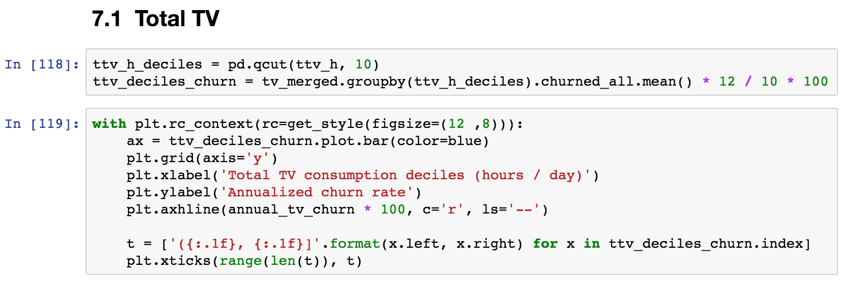
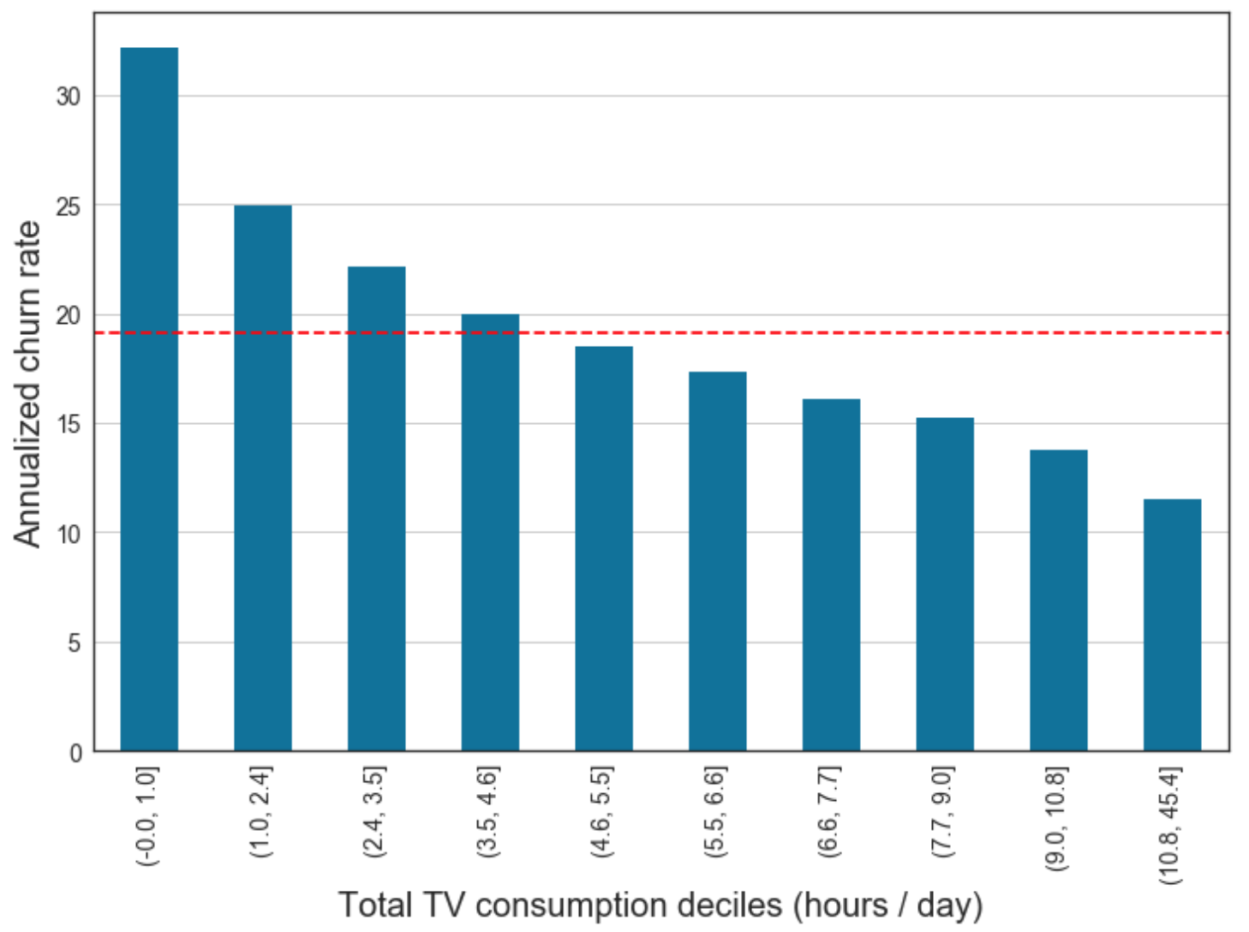

The good news: you can smell it

Slide 4
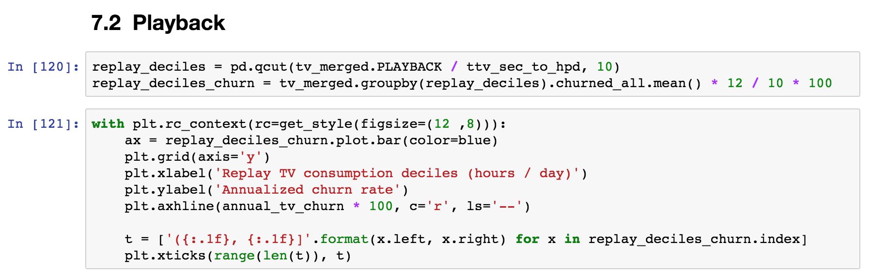
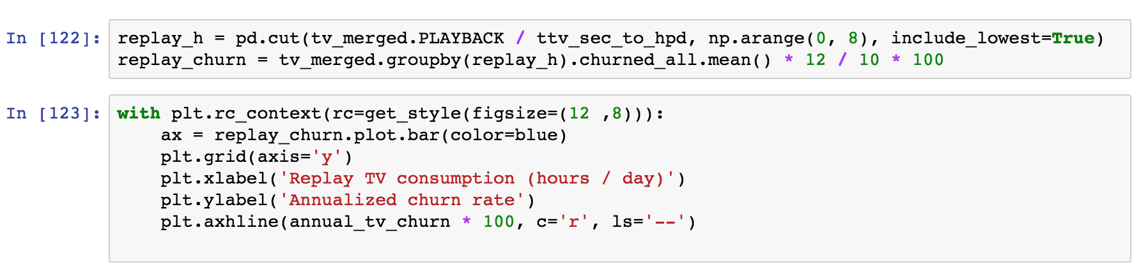
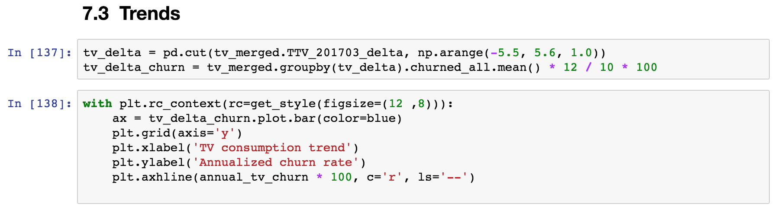
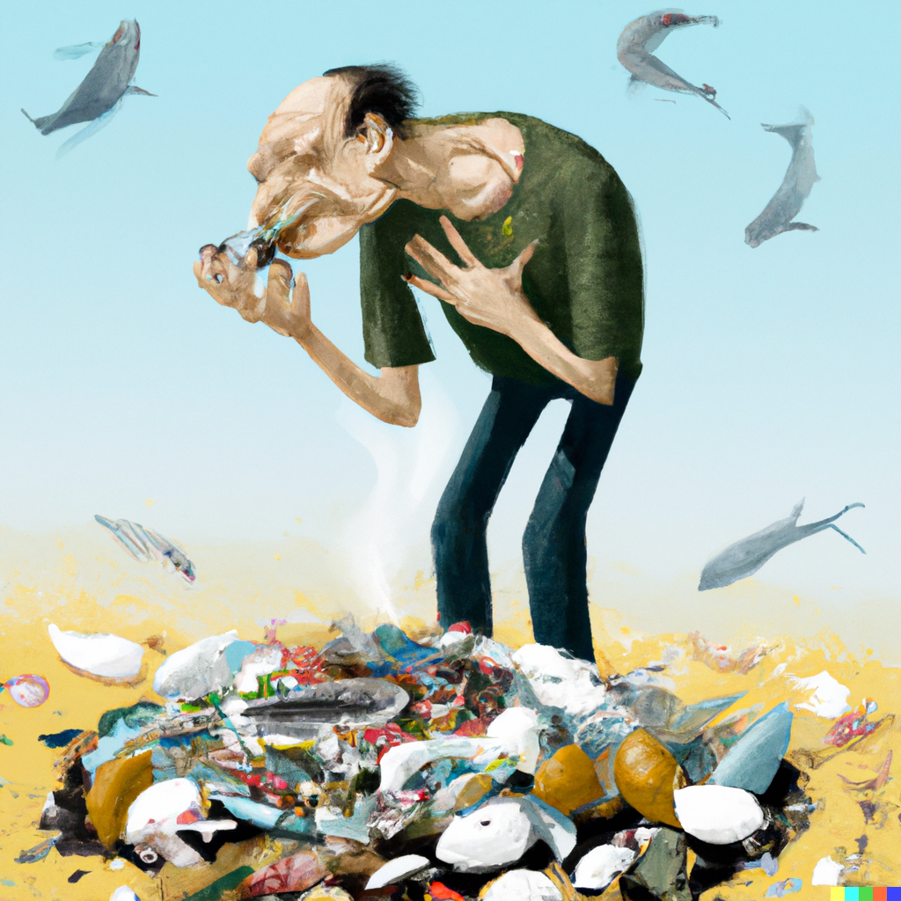
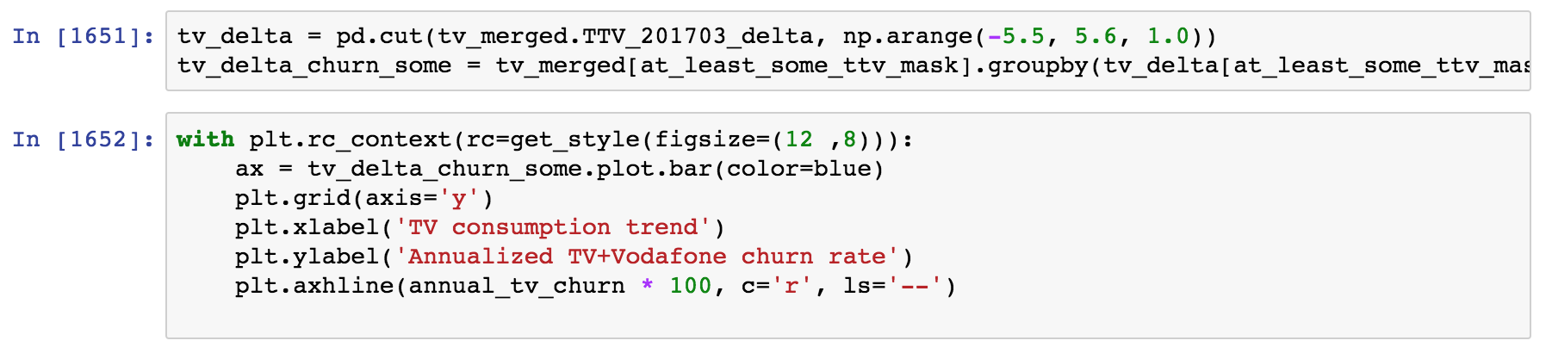
The good news: you can smell it

Slide 5
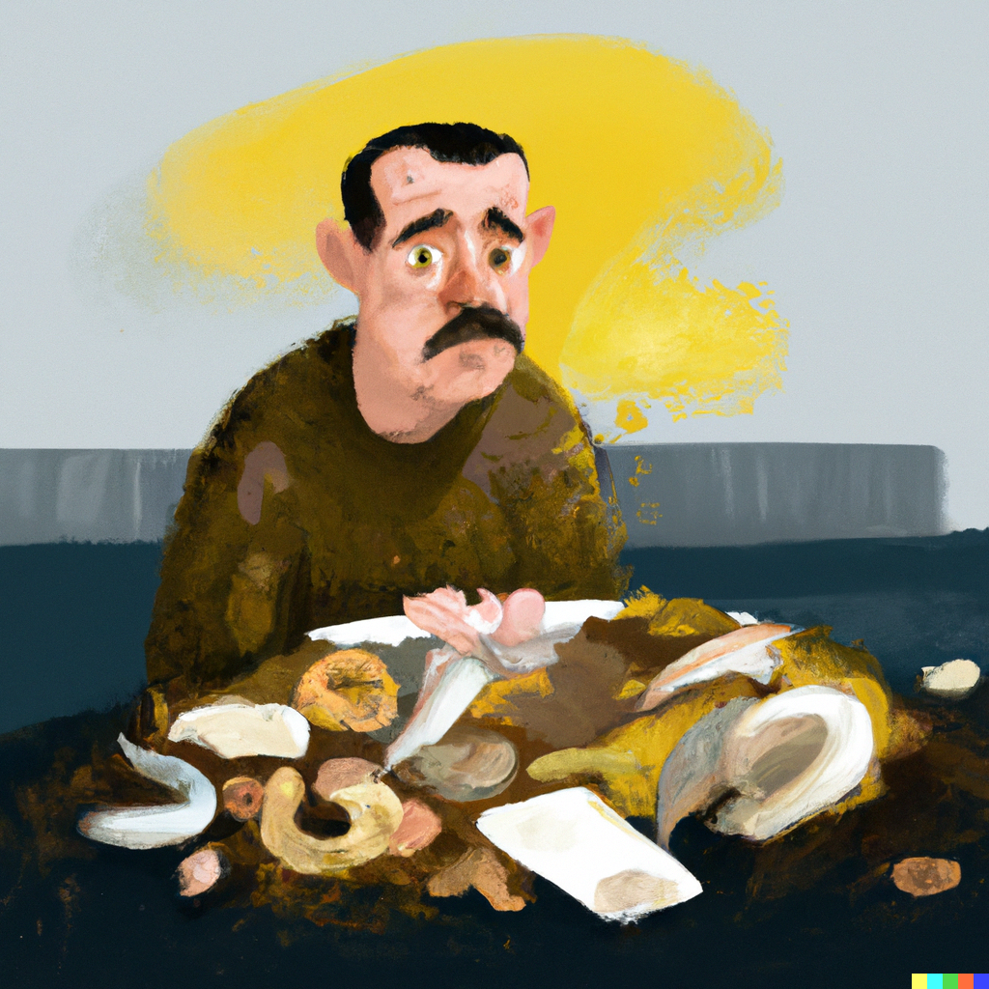
What is wrong with smelly code?
Smelly code might work right now, but in time it is going to have one or more of these issues:
Redundant: an update in one place would need to be duplicated multiple times
Hard to read and test: the code that performs the interesting computation is mixed with the code that does the repetitive boilerplate
Not flexible: adding new functionality and modifying exiting features require extensive rewrites or hacks

Slide 6

Here is how to fix it, class dismissed
What are you missing? A few patterns that make your code odor as nice as a spring meadow
Group together things that belong together
Break out things that vary independently
Keep code open for extension
Notes:
These constructs are not very common in scientific code, and you don’t actually ”need” them. But the same is true of functions!

Slide 7

Chapter 1: Introduction to classes Put together things that belong together

Slide 8

Classes live coding
Live Coding
notebooks/01a Classes.ipynb

Slide 9

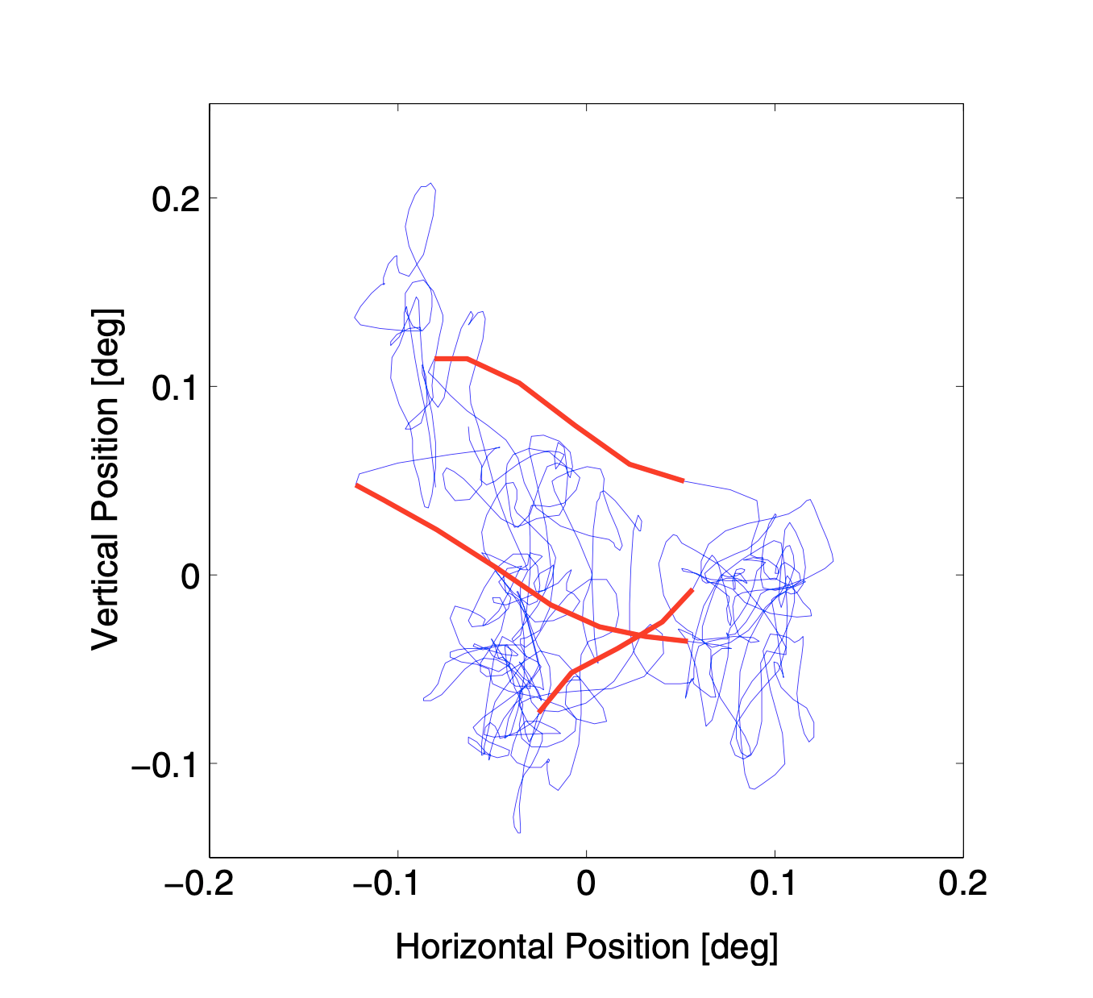
Excursion: let’s walk!
Even when people think they are holding their eyes still, they still move around:
Drift, Microsaccades, jitter
The movement has statistical properties such as self avoidance, directional persistence…
The upcoming exercise is a simplified version of a model Lisa is working on

Slide 10
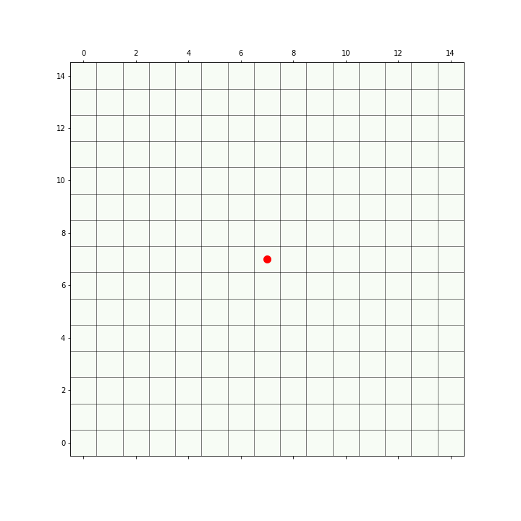
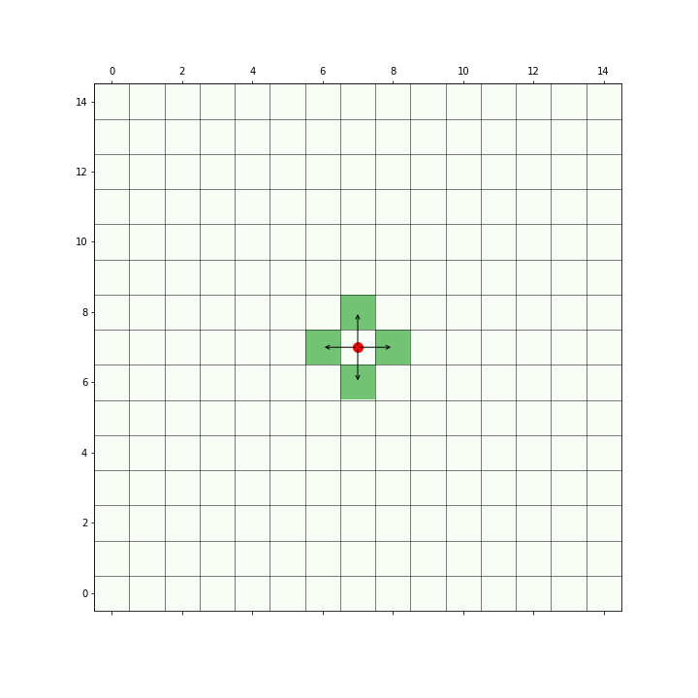
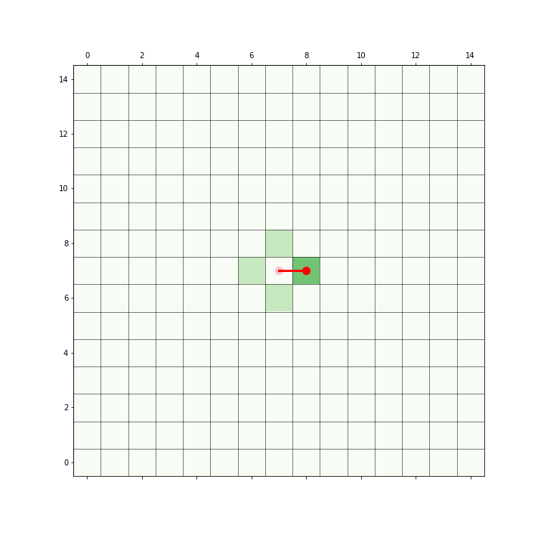
Excursion: let’s walk!
Walker starts somewhere
It could walk one step in any direction
It randomly selects one step

Slide 11
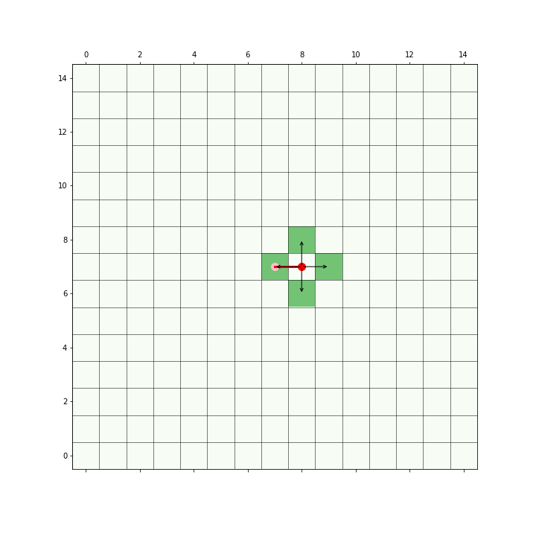
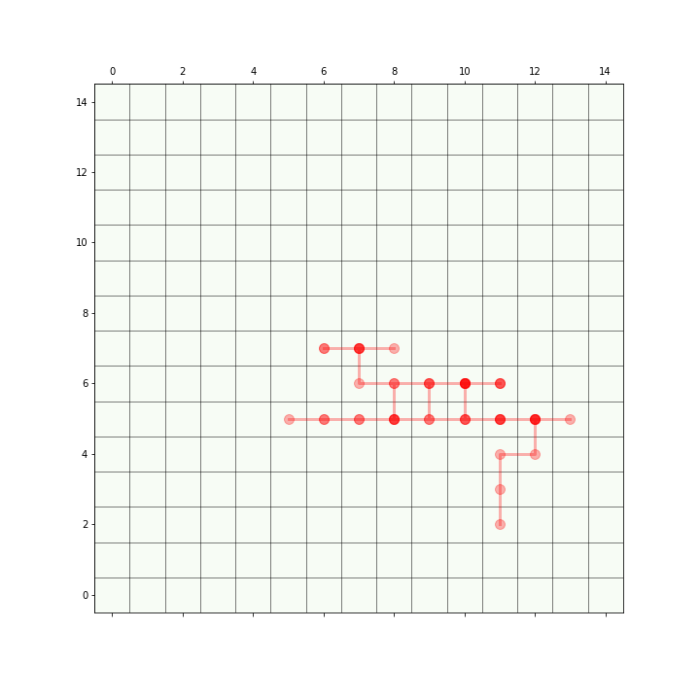
Excursion: let’s walk!
In the next step it has the same stepping options
By iterating this procedure, we get a trajectory

Slide 12
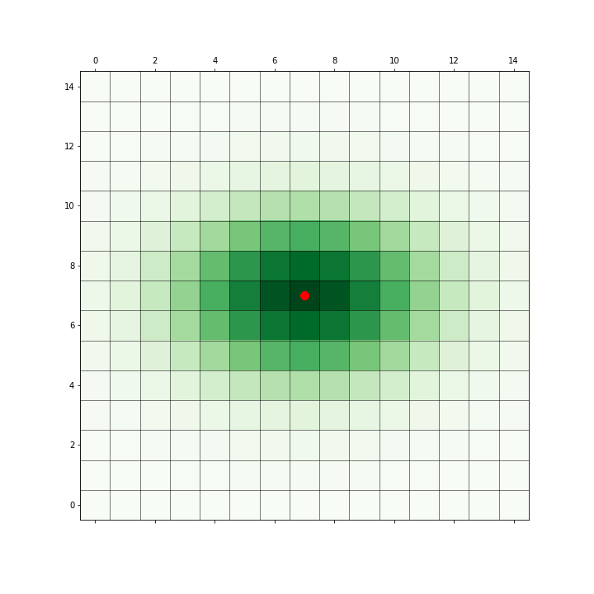
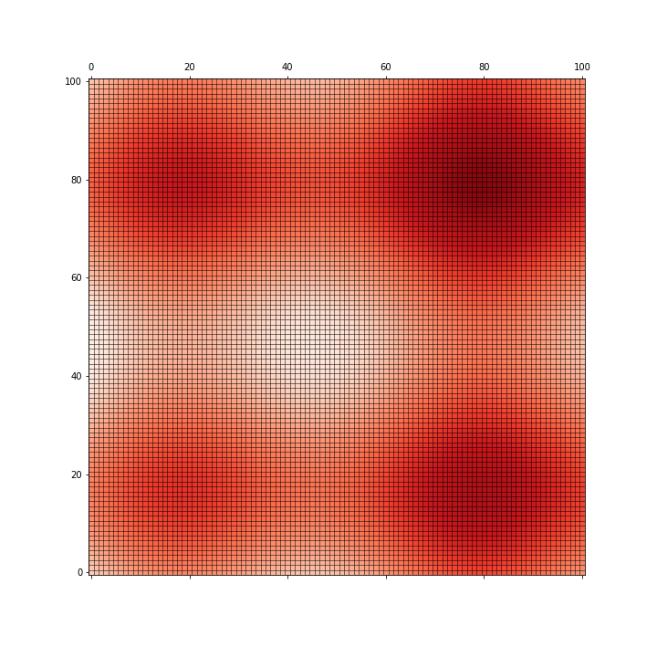
Excursion: let’s walk!
To make the behavior a little bit more interesting the walker in the exercise…
choses its next step from a probability
Can also walk over a non uniform background, that influences how likely it is to go there
Stepping Probability
Background Activation

Slide 13
The walker Functions
Live Coding
walker/01 Introduction/

Slide 14

Hands-on Turn the walker code into a class
Exercise
walker/Step 1 classes/
All the exercises in this class are about reformatting code! You are not expected to go into detail about how the code works- copy&pasting is fine!
There are many ways to solve the exercises. It is more important to think about the implementation choices with your partner than to finish. We will give you working code to start from at each step, so don’t worry about finishing!
Submit a PR for Issue #1 on GitHub.

Slide 15
After exercise, open discussion notes
To be removed from final slide deck
Classes group data and functions that belong together
Classes are used to put together sets of parameters that belong together and would be otherwise passed over and over to a set of functions
Classes are templates for bundles of data and “methods”, i.e. functions that have access to the data stored in an instance
How is the code with the class better?
all parameters are specified once at the start, grouped together nicely the signature of most functions is simplified
What belongs and do not belong to a class?
Anything for which you can imagine to write 5 different variants depending on your mood
For example, plotting code: write functions that take instances and create a plot instead. This also helps separating the dependencies from plotting libraries from the computational code. Related to Model-View pattern
Smell: a method that does not use any of the data in the instance
Which methods should be private?
think about the “interface”, i.e. the part of the class that an external user is supposed to use directly
Design questions
- should i, j belong to the class? - should random_state belong to the class?
What are the smells that remain?
# need to do the bookkeeping for i, j in case you want to create / simulate entire trajectories # changing the next step probability is going to be trouble # adding a new activation map requires adding a new piece to the code # what if map_type is not any of the 3?

Slide 16
Summary: Classes organize your code
class Xyz:
def __init__(self, x, y, z):
...
def first_function(self):
# Something
def second_function(self):
# Something else
def third_function(self):
# Something more
def first_function(x, y, z):
# Something
def second_function(x, y, z):
# Something else
def third_function(x, y, z):
# Something more
… becomes …
Classes help us group data and functionalities that belong together
When used judiciously, the code becomes more usable as we get rid of a lot of manual book-keeping; details are hidden away
Understanding what belongs to the class and what does not is important to keep the code flexible!

Slide 17
Chapter 2: There are many ways to build an instance Break out things that vary independently

Slide 18
There are many ways to build an instance
In tests, typically one wants to specify all the parameters *exactly*
Sometimes there are multiple ways of setting the parameters, e.g. setting the initial weights in a neural network
The instance could be created from some saved parameters (serialization)
Open discussion notes:
Look at Walker class, if/elif part – that’s an example of having multiple ways of initializing the activation_map.
What do you think of it?
Have you seen this kind of situation before?
What happens if we want to add a new activation map type?
What if a colleague wants to do the same?
What happens if I want to test that one of the initializations is correct?
What do you think is the smell, and how would you fix it?
To be removed from final slide deck

Slide 19
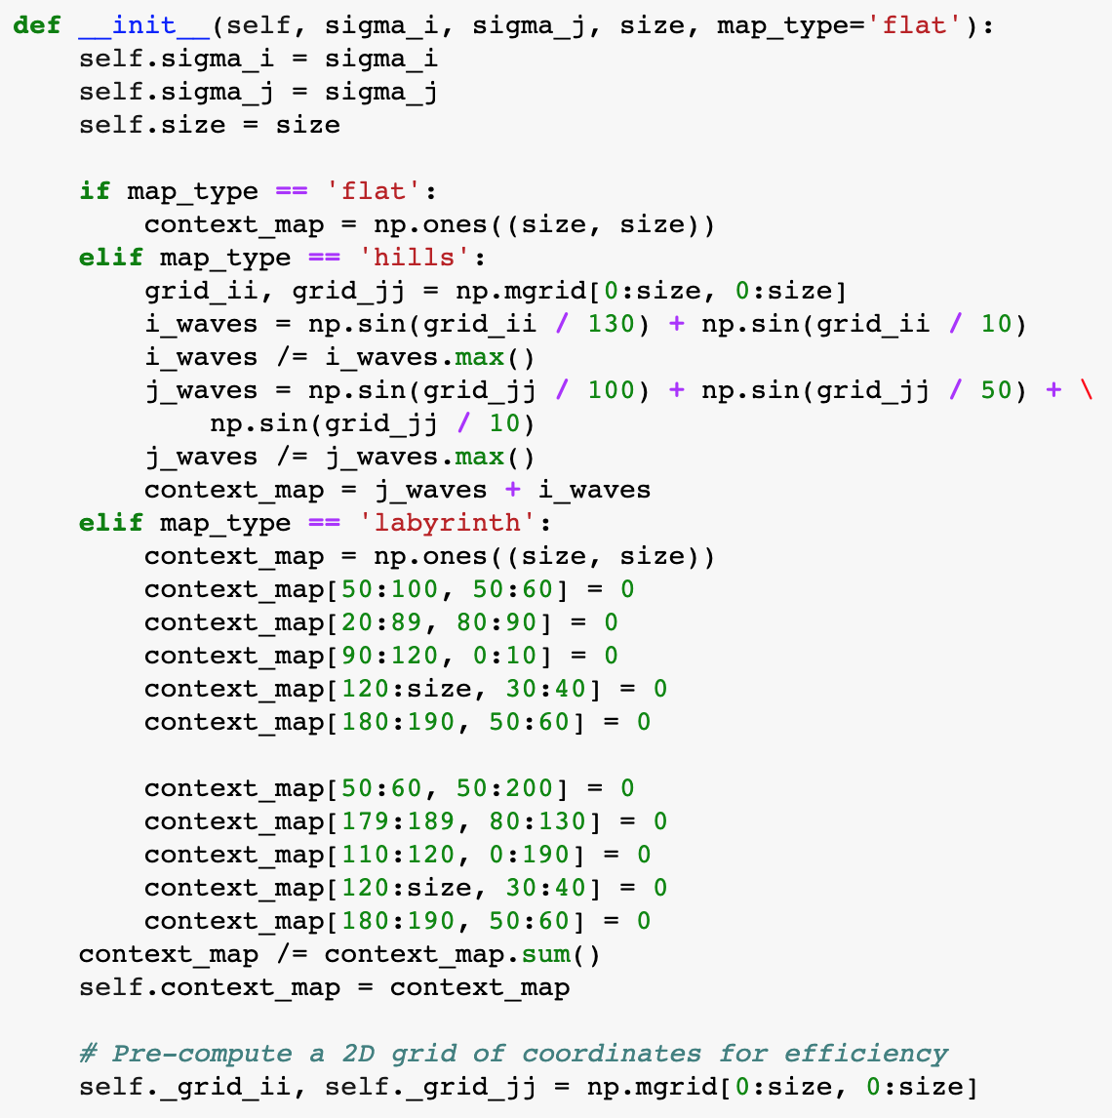
The smells of the Walker constructor

Slide 20
The smells of the Walker constructor
The constructor will become longer with more initialization types
We cannot contribute a new initialization type without modifying the code
It is difficult to test
It is not flexible, e.g. what happens if we want to create an instance from parameters saved on file?
How would you fix it?

Slide 21
The smells of the Walker constructor
The constructor will become longer with more initialization types
We cannot contribute a new initialization type without modifying the code
It is difficult to test
It is not flexible, e.g. what happens if we want to create an instance from parameters saved on file?
These are smells of the fact that the initialization of context_map varies independently of the class Walker
We need two ingredients to fix this

Slide 22
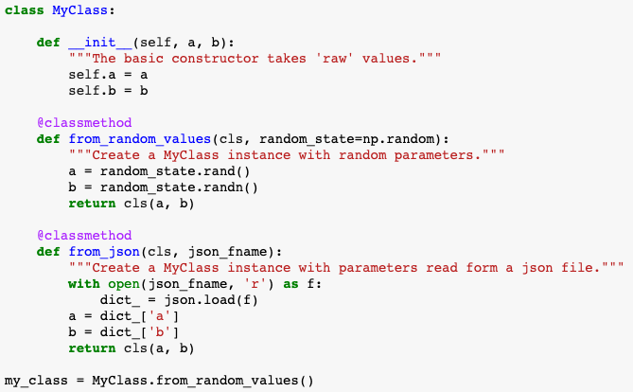
Factory methods build instances in different ways
The main constructor should not do anything fancy
The factory methods create the parameters in some fancy way, then call the basic constructor
A @classmethod is a method that takes a reference to the class, not the instance, as its input
Their main use is as factory methods, to create instances

Slide 23
Live Coding factory methods
Live Coding
walker/Step 2 factory method/

Slide 24
Persistence and serialization: Saving grouped data
Persistence: saving the state of an instance to disk
Serialization: transforming an object into another representation; in this context, something that can be saved to disk
pickle
Easy to use, it shoud just work
It breaks easily when the code changes (a simple renaming of the class, for instance)
JSON
the file equivalent of a dictionary
you’ll need to handle the transformation to and from json yourself
custom types like Numpy arrays are not supported by default, need to turn them into lists or strings, or else save them separately and add the path in the JSON file

Slide 25
Serialization live coding
Live Coding
notebooks/02a Serialization.ipynb

Slide 26
Hands On: Serialize the Walker
Exercise
walker/Step 3 serialize/
Submit a PR for Issue #2 on GitHub.
Have a look at the “Step 2 factory method” notebook
Write the walker.to_json() method and walker.from_json()factory method

Slide 27
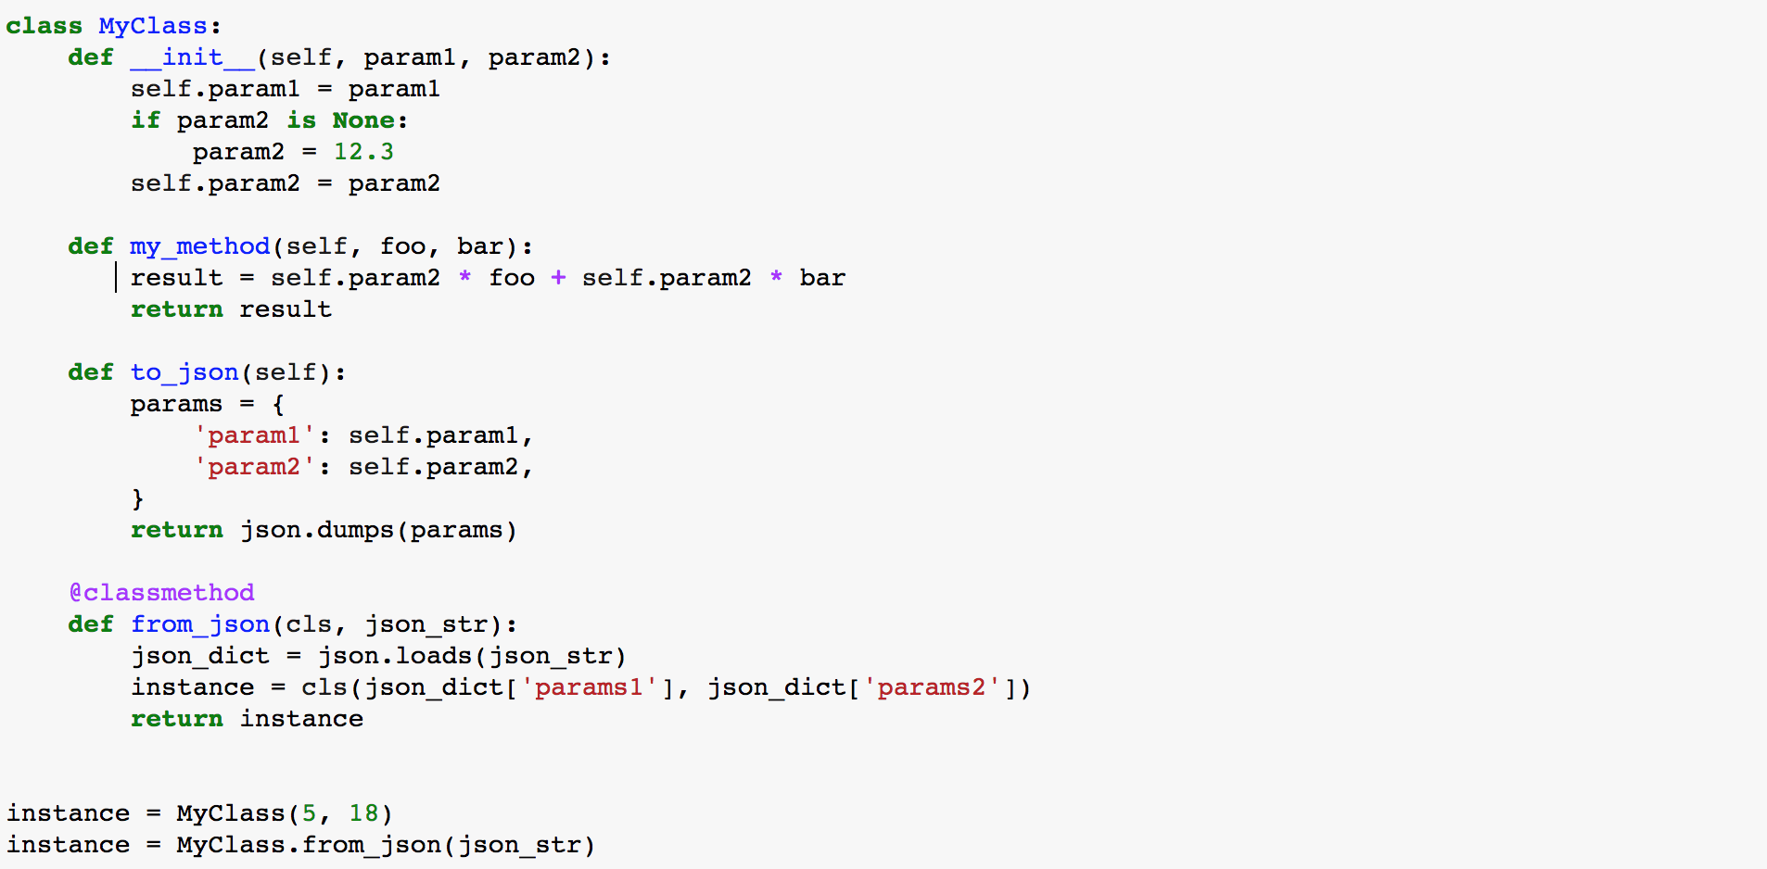
Recap: Class structure
The constructor is used to first populate an instance, called by convention “self”
Classes can define “methods”, i.e. functions that have access to the data stored in an instance
A ”class method” can be used to build an instance in some alternative way, e.g. using data from a file
Here is how you create instances from the constructor or a class method

Slide 28
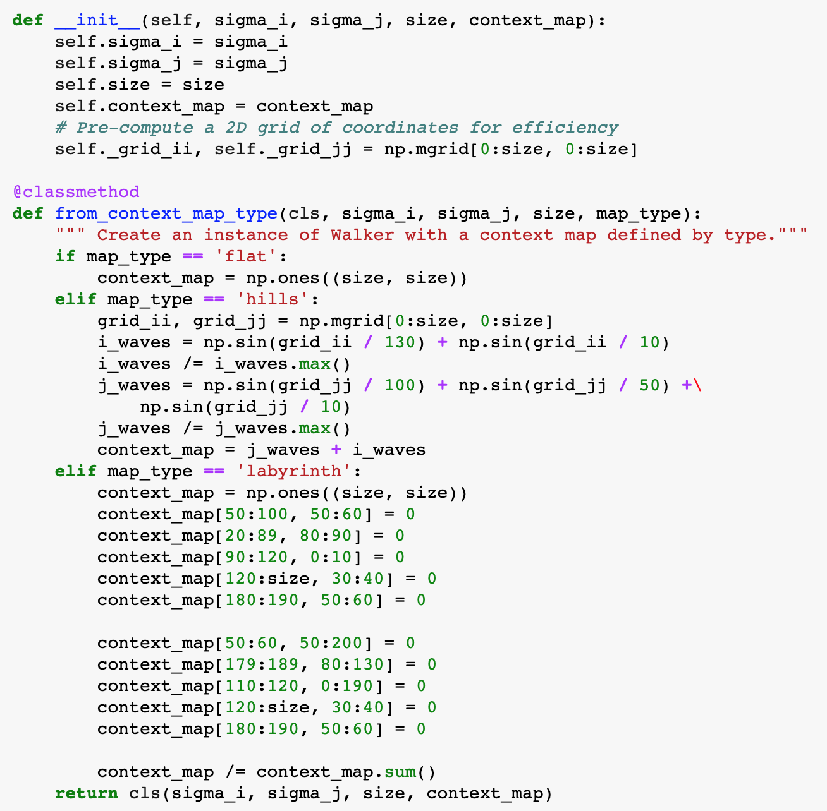

Factory methods take us only this far...
We broke apart the monolitic constructor into a basic, parameter setting part, and the specialized context-map initialization.
The constructor factory method will become longer with more initialization types
We cannot contribute a new initialization type without modifying the code
It is difficult to test
It is not flexible, e.g. what happens if we want to create an instance from parameters saved on file?

Slide 29
Breaking out live coding
Live Coding
walker/Step 4 break out the context map…/

Slide 30

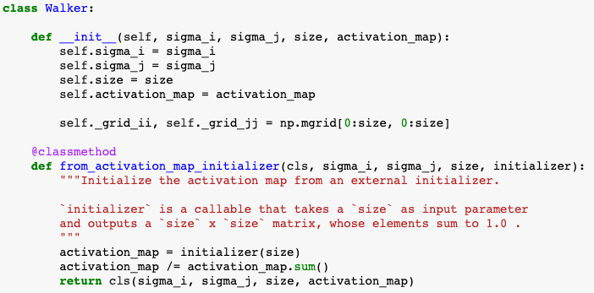
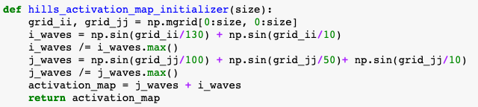
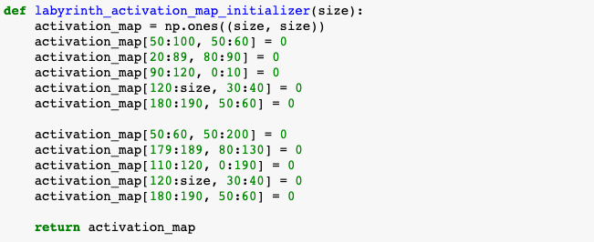
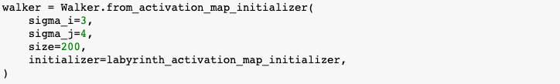
Break out the part that varies!
To be removed from final slide deck
Open discussion notes:
By breaking out the parts that can vary (initializers), the model code is much simplified. All you need to do is define the interface for the initialization method
You can add a new initialization method without touching the model! Changes to the initializers also do not affect the Walker. The code became much more flexible
We can test the initializer methods much more easily; the model as well, as we can now define a new TestInitializer that sets the ”x” to a convenient initial value
This pattern is called “dependency injection”
what to do if one initializer had a parameter?

Slide 31
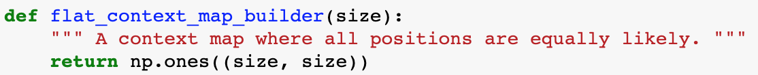
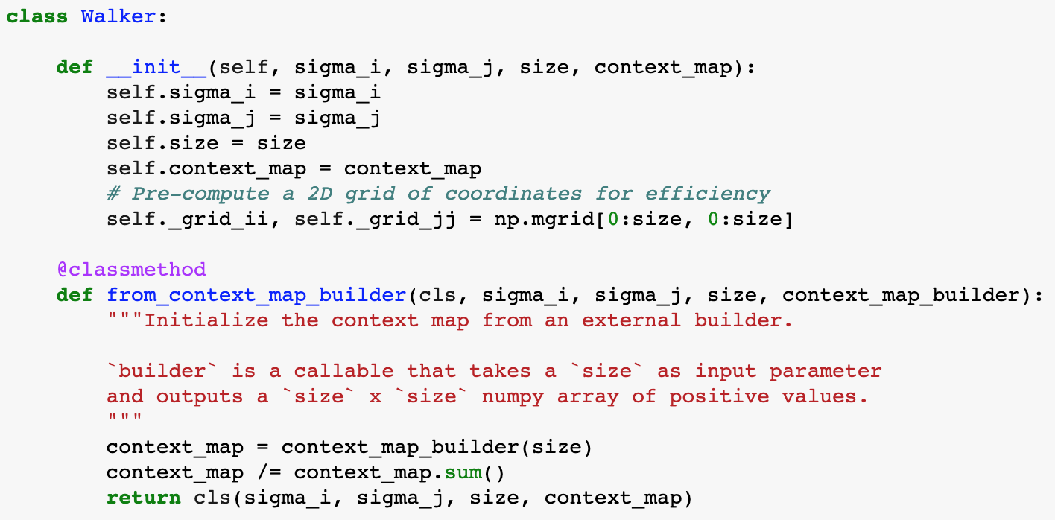
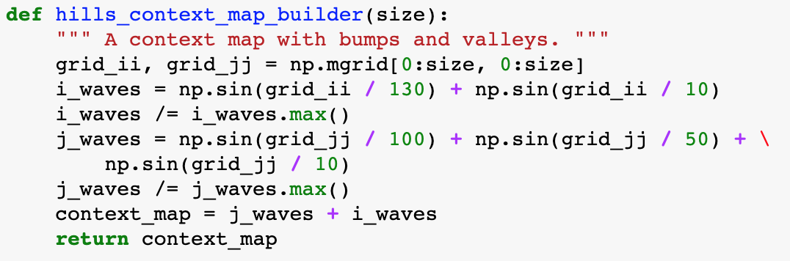
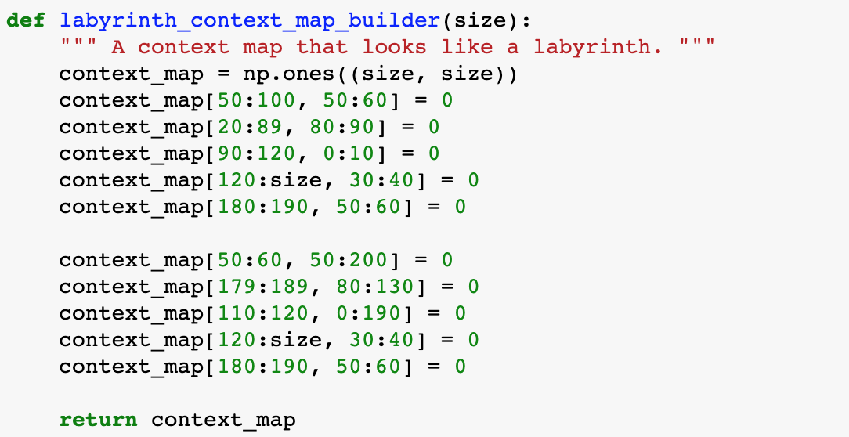
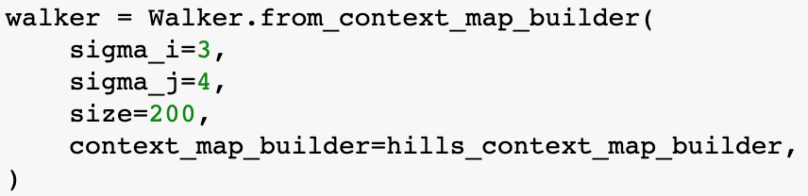
Break out the part that varies independently!

Slide 32

Break out the part that varies!
But wait, now we are passing a function, as if it were a variable!
Functions, Classes, Class Instances, Variables etc. are all treated the same way, until used in some way (duck typing)

Slide 33
Hands On: breaking out the next step probability
Exercise
walker/Step 5 break out next step…/
Submit a PR for Issue #3 on GitHub.
Have a look at the “Step 5 break out next step probability” notebook
In it you will find some different ways of computing the next step probability. Break out the next_step_probability function to initialize the walker with different variations.

Slide 34
Separate what varies independently Part 2 The same principle applies everywhere, including at the level of project

Slide 35

The holy trinity of scientific computing
Provenance
Reproducibility
Organization

Slide 36
The holy trinity of scientific computing
Provenance
Reproducibility
Organization
It needs to be clear where data and plots come from, when and how they were generated
All information necessary to get the same result needs to be saved
For your own sanity, you should have a consistent system for all this data and artefacts

Slide 37
Discussion Points
Has it ever happened to you that you had a figure and no idea which version of the code produced it?
How do you typically manage your research code?
Is there one folder with everything? How is it structured? Does each run of the code overwrite the previous files? Do you have dates in the filenames?
Which metadata do you save?
Where does the data live?
Reproducibility: what about randomness (sampling?)
To be removed from final slide deck

Slide 38
1. Provenance
Data Provenance, or lineage, documents where data comes from
Recording when and by which code the dataset has been changed
But HOW?
External software? Usually not scpecific for scientific usecase.
Folder structure/Filenames?
Code generated meta-information files? (see next slide)
In case of plots: data generated the plots
For work in progress plots: plt.annontate()
Save .ipynb as pdf (with all the paths/version information in the notebook)
Could use meta flags in images https://github.com/dfm/savefig

Slide 39
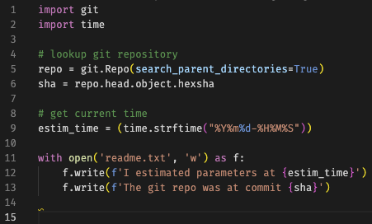
2. Reproducibility
Save all information necessary to get the same result again
All input parameters to the code
Randomness- if used, save the seed
Which version of the code was used?
Serialization of intermediate steps in the code (estimation and analysis)

Slide 40
3. Organization
Research Project (Modelling)
Research Project (Analytical)
Model
Parameter Estimation
Analysis
and Plotting of Results
OR
Data Pre-processing pipeline
Statistical Analyses
Plotting of Results
Your research project may look something like this (or maybe you have different steps or a subset of steps)
In any case it is likely that you will go through the steps many times before you‘re ready to publish your work

Slide 41

3. Organization
Research Project
Model
Parameter Estimation
Analysis
and Plots of Results
Data
Estimation
Parameters
(input)
Estimated Model
Parameters (output)
Simulated Data
Meta Data from estimation
(input, output)
Meta Data from Analysis
(input, output)
Each run has a bunch of associated data resulting folders and folders of data where no one knows which version of the code generated it or is using it!

Slide 42
3. Organization
Suggestion:
Data should always be separated from code
The model or algorithms or things that are applied to your data should be packages (see packaging lecture)
Think of “runs” as Experiments. Each experiment has its own folder. The folder contains:
Minimal code that calls the model and saves the result
All inputs necessary to produce the result saved separately
Meta information about which version of your code was used (and maybe a note about what you were trying to achieve, if you want to be extra nice to future you)
The result
Maybe the visualization of the result
Research folder
data
model
projects
parameter estimation
22_08_30_estimation
22_09_01_estimation
(1) run.py
(2) inputs.json
(3) meta.txt
(4) result.npy
(5) visualize.ipynb

Slide 43
Organization
Research folder
Base dataset
data
Provenance
Reproducibility
Organization
model
projects
Informative File/folder names
parameter estimation
22_08_30_estimation
Info about when and how data was changed
22_09_01_estimation
Where does this data come from?
(1) run.py
(2) inputs.json
(3) meta.txt
(4) result.npy
(5) visualize.ipynb

Slide 44
Organization
Research folder
data
Provenance
Reproducibility
Organization
model
Code package that can be re-used
projects
parameter estimation
22_08_30_estimation
Parameters, inputs, seed etc.
22_09_01_estimation
(1) run.py
Code version, date
(2) inputs.json
How do we reproduce these results?
(3) meta.txt
(4) result.npy
(5) visualize.ipynb

Slide 45
Organization
Research folder
data
Provenance
Reproducibility
Organization
model
Split code and analyses
Split data and code
projects
parameter estimation
22_08_30_estimation
Separate folders for „experiments“ and „runs“
22_09_01_estimation
(1) run.py
(2) inputs.json
(3) meta.txt
(4) result.npy
(5) visualize.ipynb

Slide 46
Discussion
Research folder
Which of these things should be in git? Which should not?
Should „research_folder“ be git versioned? Or separate git repos for each subfolder?
Which kind of thing is happy in a notebook? What should be a .py script? A package?
How do we keep track of versions? How do we write the „meta“ file?
Python git package can read the hash
Dated folders
Pip freeze
Data
model
Projects
Parameter Estimation
22_08_30_estimation
22_09_01_estimation
(1) run.py
(2) inputs.json
(3) meta.txt
(4) result.npy
To be removed from final slide deck
(5) visualize.ipynb

Slide 47
Summary: Breaking things out at the level of projects
break out run parameters and code
what is parameters injection
manager code: small amount of code reads the run parameters, create the appropriate classes, injects the parameters, and runs
it’s a coordination job, all the science is done elsewhere
separate calculation and analysis of results
recurrent research project concepts: projects, experiments, runs
break out data and code
data not in git
what is lineage, versioning
Some “input” data is common to the whole project

Slide 48
Hands On: Final Exercise
Exercise
walker/Step 6 full workflow/
Go through the following steps!
Submit PR for Issue #4 on GitHub
Look at the inputs.json file
Use your Walker class to simulate a Trajectory
Write some code that automatically generates a file with information about the run (time, git hash, run time, your favorite color…)
Save the trajectory and walker

Slide 49


Thank you!

Slide 51
Keep things open for extension
Bonus material

Slide 52
Hooks patterns
Bonus material
common cases:
in graph traversing algorithms (e.g., depth-first search) the graph traversing is generic, but the operation to be done with the data on the nodes is specific to the application. Graph libraries often implement the traverversing, and allow implementing the operation through hooks (hook when first visiting node, and when all children are visited on the way back)
in some UI frameworks, hooks can be added to react to certain UI events

Slide 53
Architecture discussion?
walker.from_data(data)
walker.fit(data)
walker_from_data(data), return fitted instance
fit(walker, data), return parameters
trajectory from walker
walker.trajectory(n_steps) (hooks might be useful)
trajectory(walker, n_steps) (hooks not so useful – just write another trajectory creator)

Slide 54
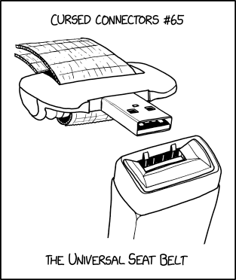
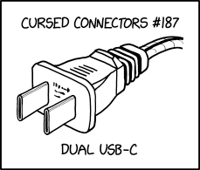
What is an API?
How is the interface between your code and your manager scripts?
Other things to consider when writing your code:
Who will be using it?
Maybe your code has a practical application
Even if it‘s most likely no one, imagine someone trying to replicate your research after you publish
Are there parts of the code you may want to use in your next project?
E.g. a fitting algorithm can be reused when you move on to the next model
E.g. a class for your data may be reusable for the next dataset

Slide 55
Where to go from here…
realpython.com

